Slide 1

Rubellite
Group No : 07
Chandni Patel 15
Hetal Poriya 20
Date of presentation: 28 August 2019
Under the guidance of: Sonali Vadiya Ma’am
St. Francis Institute of Technology
Department of Information Technology

Slide 2

Content
Introduction
Objective and scope of project
Problem definition & Proposed solution
Comparative study of Existing systems
Hardware & Software requirements
User Interface Design
Results and Discussions
Conclusions
Future Scope
Literature Cited (book, web & paper References)

Slide 3
Introduction
Our website Rubellite will provide unique range of imitation jewellery for every occasion and which will be pocket friendly for the users.
One can shop their ready to wear designer collection to suit one’s personal style. To dress up in a less budgeted way this is the most reliable site.

Slide 4
Objective and Scope of project
The website is user friendly
The website will provide a wide variety for every occasion
For a complete look based
It provides express delivery
Easy making choice

Slide 5
Problem definition
Usually to buy that one perfect jewellery we search around many places that wastes lot of time and money. So to overcome this problem this system is developed where they will get variety of choices and the jewellery to choose from.

Slide 6
Proposed solution
Rubellite is an online marketplace of curated fine jewellery. It offers a wide range of jewellery products and is a leading destination for online shopping. It offers some of the best prices and hassle free experience with various paying options.

Slide 7
Comparative study of Existing systems
Sr. No. | Features | www.fashioncrab.com | www.cilory.com | www.mirraw.com | www.rubellite.com
1 | Responsive | yes | yes | yes | Yes
2 | Website Structure | proper | proper | proper | Proper
3 | Data Placement | Proper | proper | proper | Proper
4 | Social Media Login | yes | yes | yes | Yes
5 | Social Media Link(Digital Footprint) |  |  |  | No
6 | Redundant data | no | no | No | No

Slide 8
7 | No broken Links | yes | yes | Yes | Yes
8 | Navigation Bar | Yes | yes | yes | Yes
9 | Geo Location | no | No | No | Yes
10 | Fav icons | Yes | Yes | Yes | No
11 | Feedback | no | yes | no | Yes
12 | Logo | yes | Yes | Yes | Yes
13 | Use of appropriate images | Yes | Yes | Yes | Yes
14 | Font types and sizes | Yes | Yes | yes | Yes

Slide 9
Hardware & software requirements
Software Requirements:
Adobe XD
Operating System
Sublime Text
Web Browser (google chrome )
Hardware Requirements
RAM 4gb , 8gb and more
Intel processor i5,i7 and so on
CPU CPU Intel® Core™ i5-7200U CPU@2.50Ghz

Slide 10
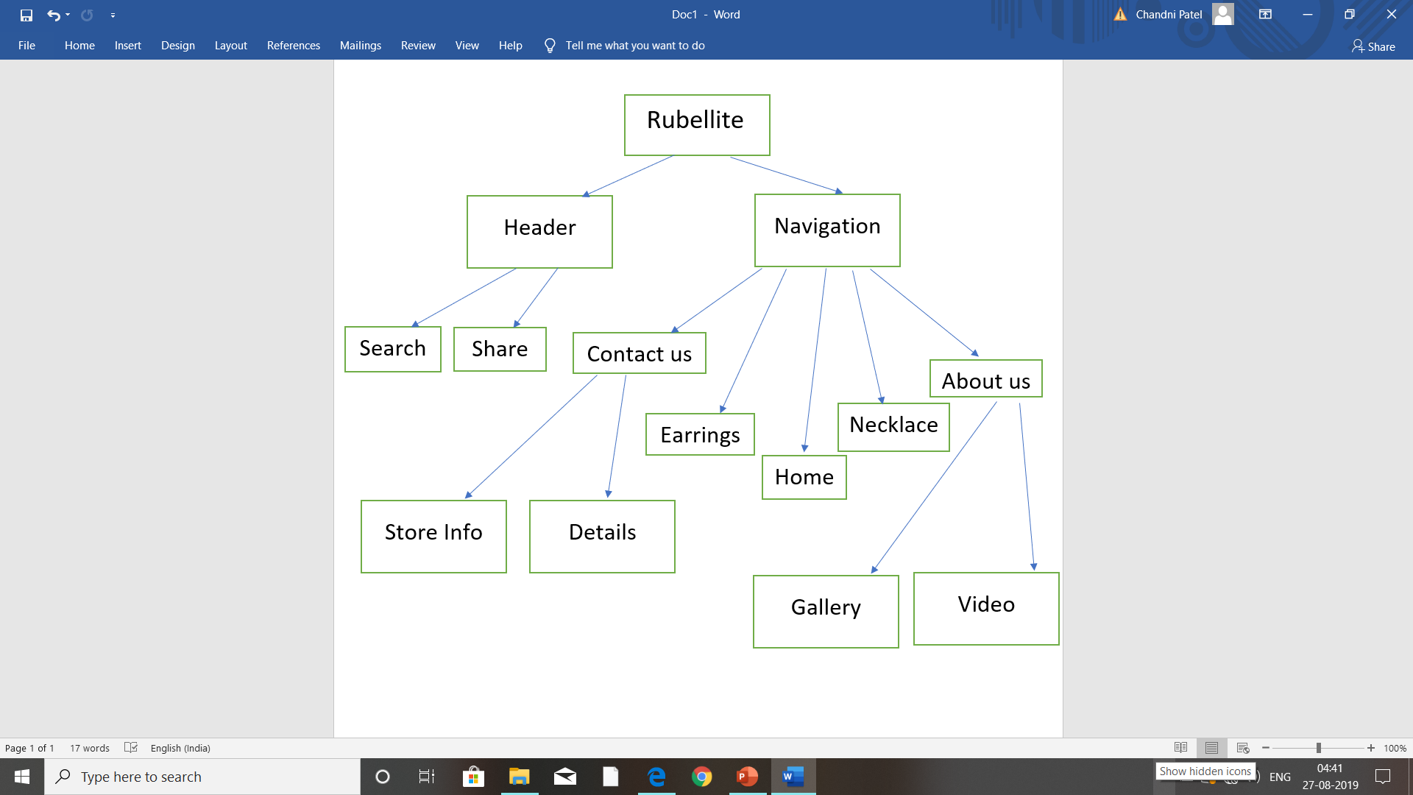
Skeleton of website

Slide 11
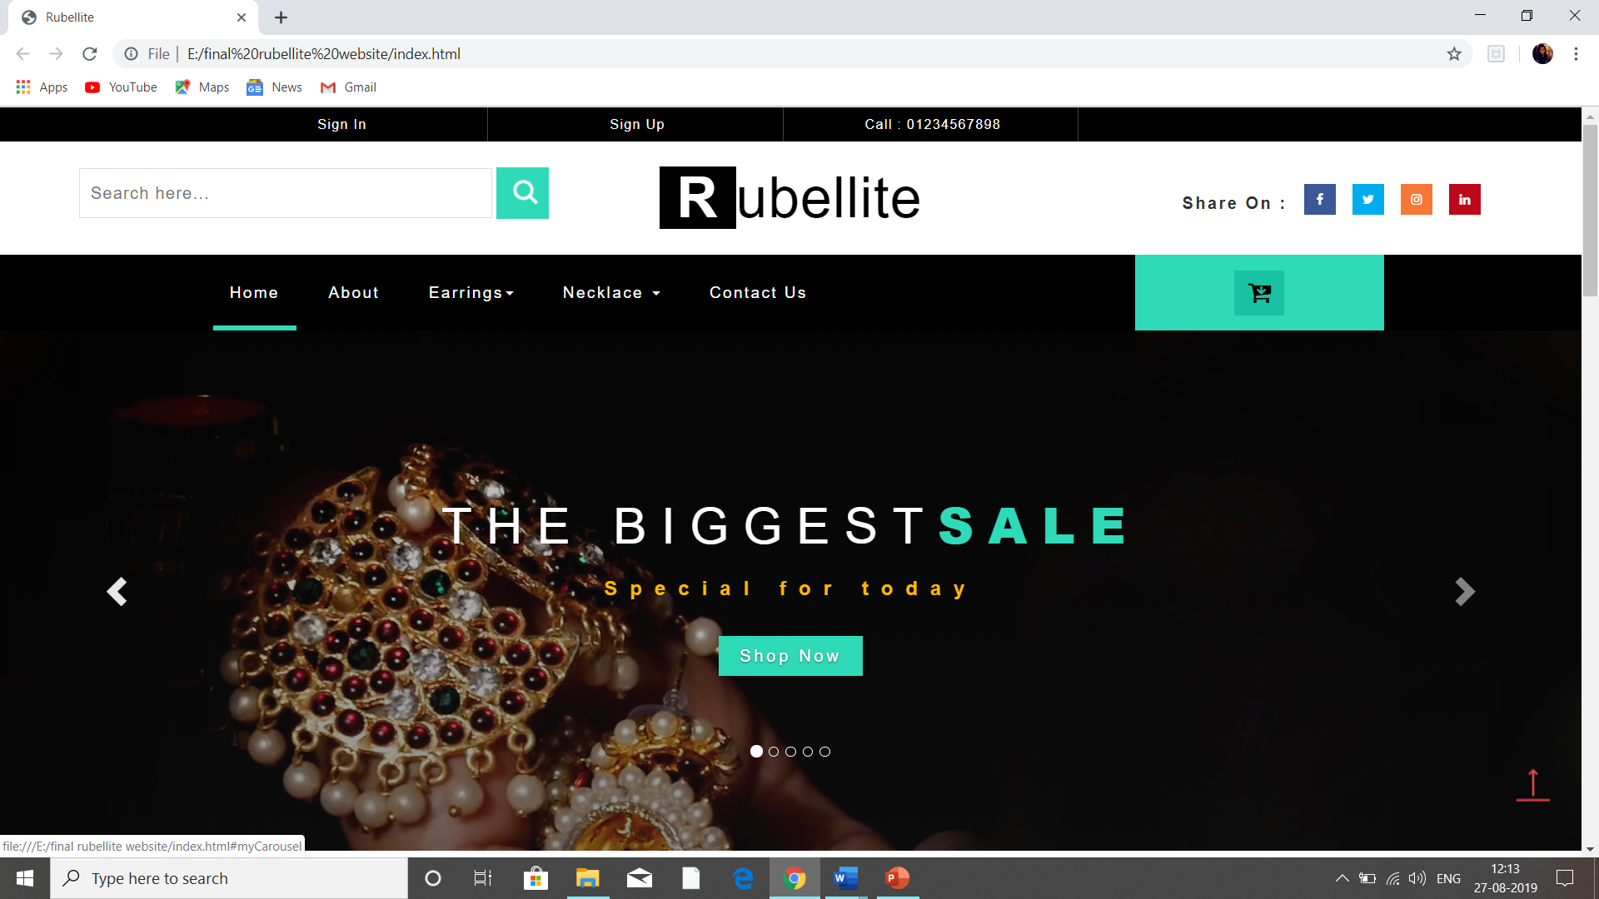
User Interface Design

Slide 12
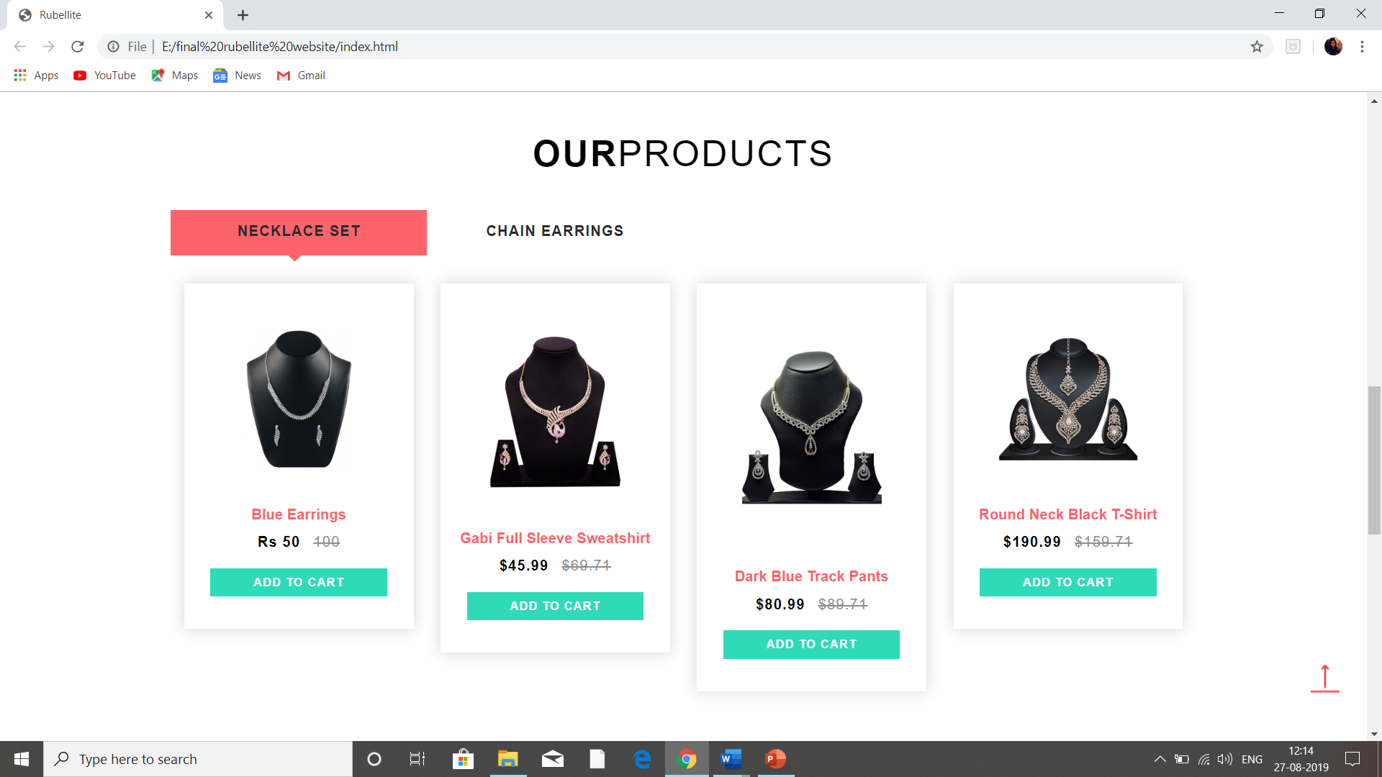
Display Products

Slide 13
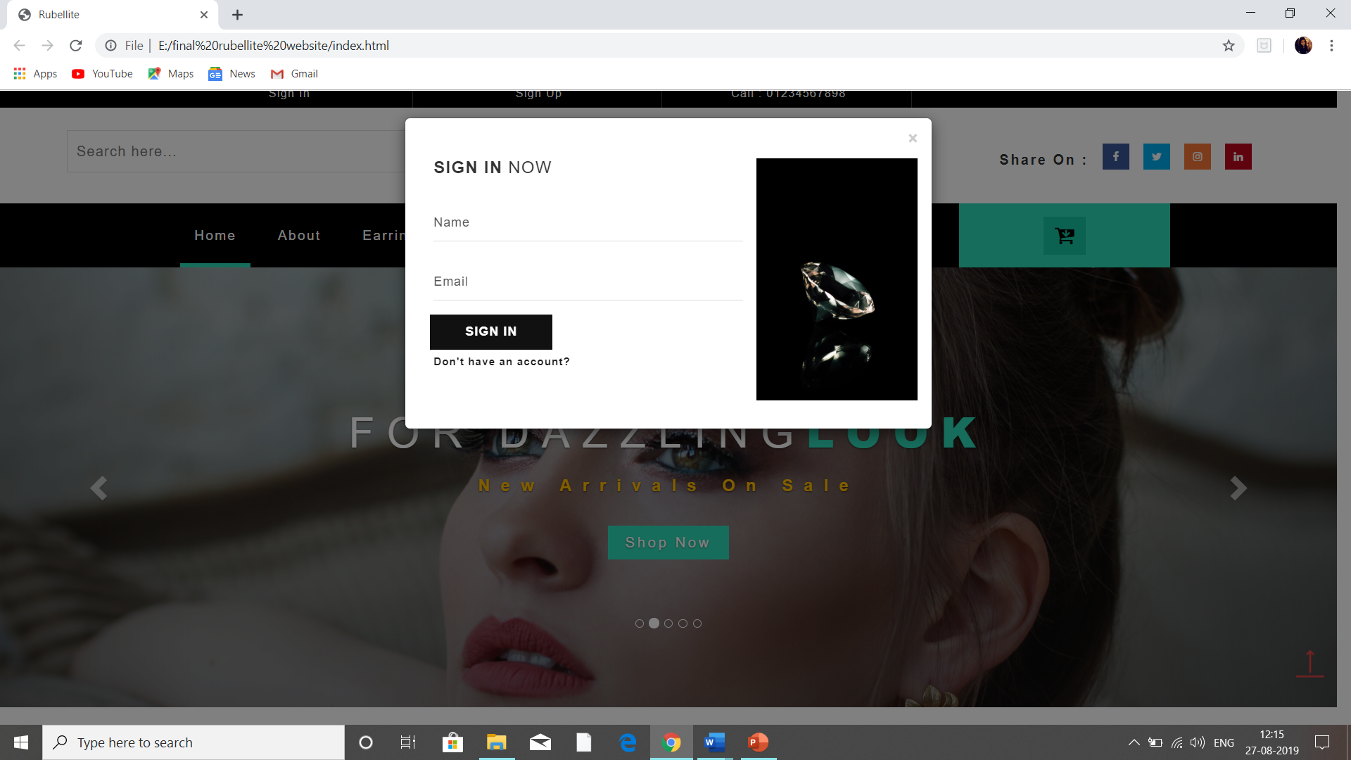
Sign in Page

Slide 14
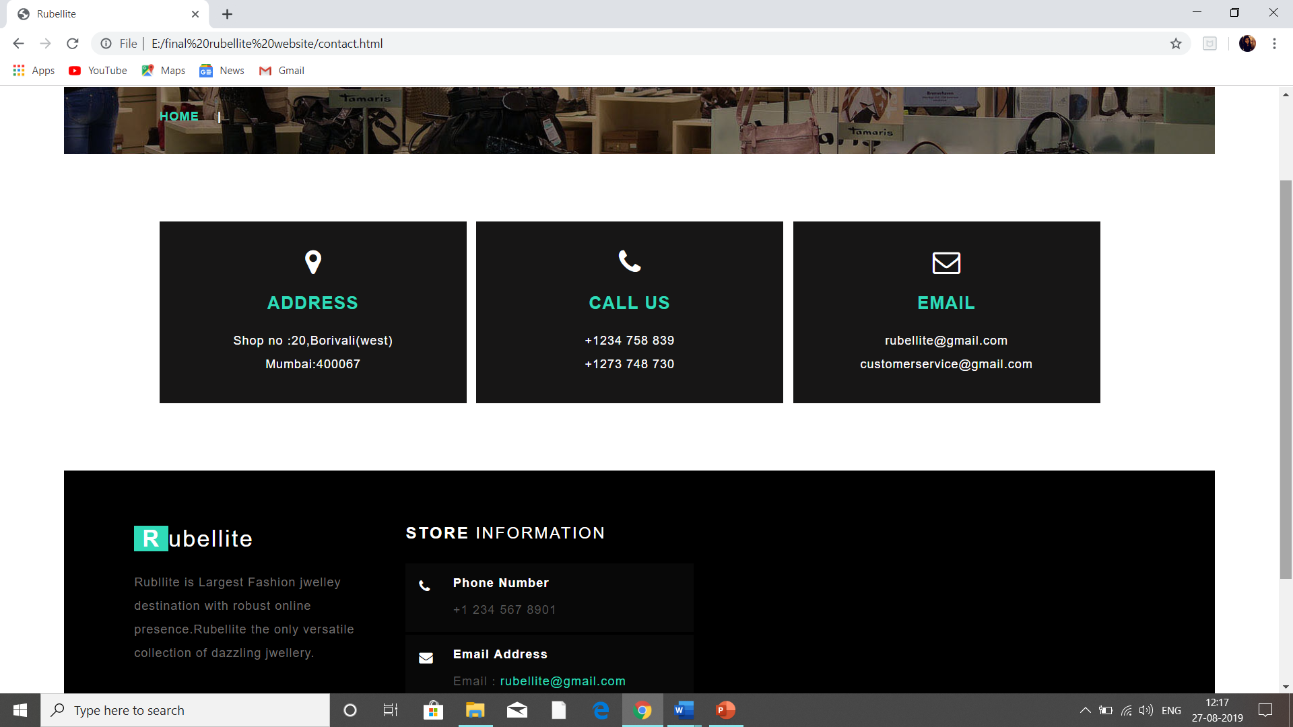
Contact Us page

Slide 15
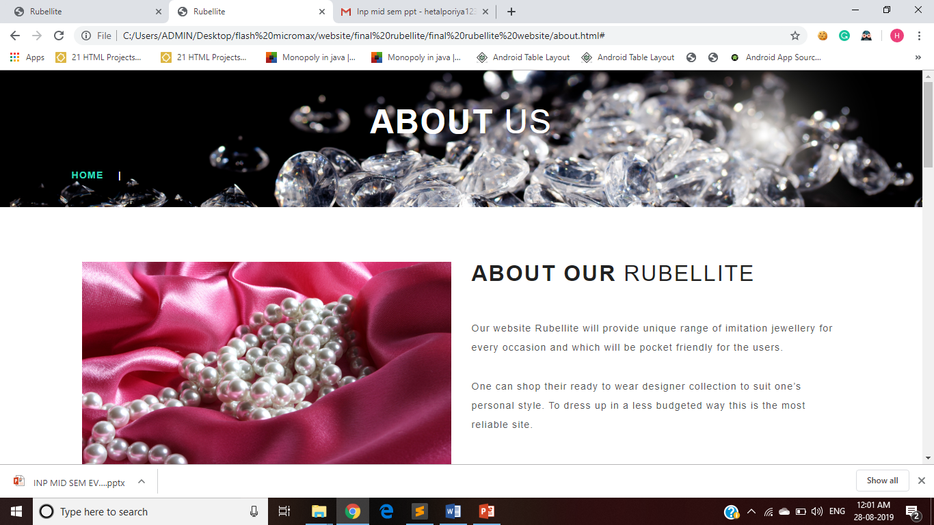
About Us Page

Slide 16
Results and Discussions
Sr. No. | Technology used | Function/feature/technique | Part of the website
1 | HTML5 | video | About us
2 | Css3 | animation | Share
3 | HTML5 | Carousel Slider | Banner
4 | JavaScript | Modal Effect | Sign in, Sign Up
5 | Html5 | Video | About US
6 | HTML5 | Semantic Element(Figure and Figure caption0 | Home page
7 | HTML | Geo Location | Contact Us

Slide 17
Conclusions
This system cares about its users convenience and need hence providing a variety of options such as cart to save their choices for later. It provides variety of options to choose the best matching jewellery and thus saving time and money.

Slide 18
Future Scope
The website will provide customization where a user can customize their jewellery according to their requirement and as per their choice.
Implementation of security during payments and thus can be made a commercial website.

Slide 19
Literature Cited
https://www.voylla.com/
https://www.cilory.com/64-jewellery
https://www.mirraw.com/store/jewellery

Slide 20
Thank You!

